Slide 1
Pervasive Computing

Slide 2
What is pervasive computing
Pervasive Computing, also known as ubiquitous computing, is a computing paradigm in which computing technology is embedded into everyday objects and environments, allowing devices to work seamlessly and invisibly in the background to enhance user experience.
The key idea is that technology should be so integrated into our surroundings that it becomes part of our daily lives, without requiring conscious interaction or awareness from users.

Slide 3
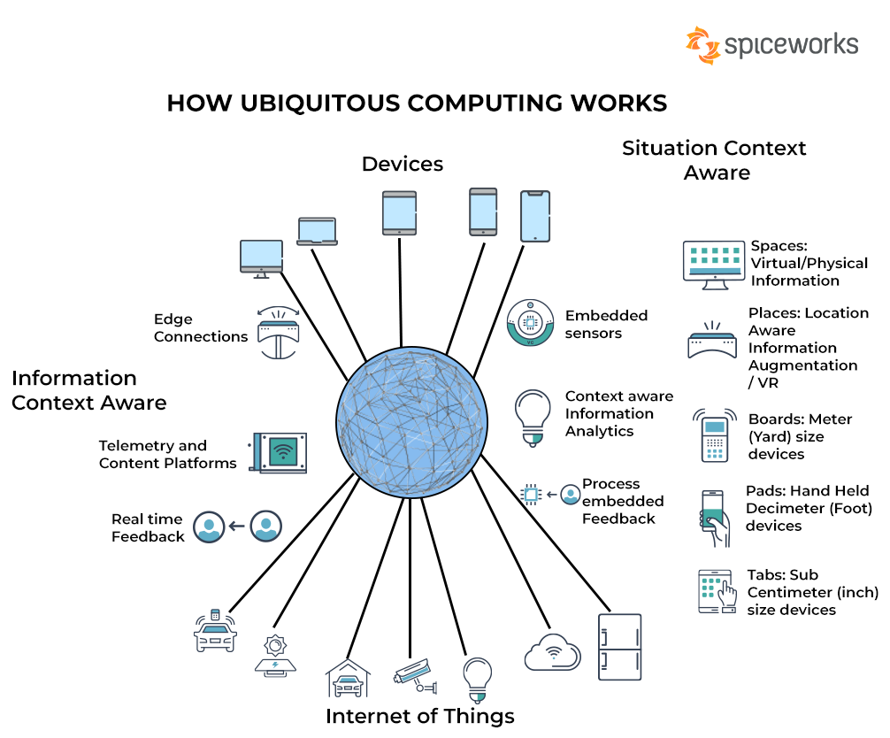

Slide 4
Key Features of Pervasive Computing:
Ubiquity: Computing is everywhere, integrated into common objects such as phones, cars, appliances, and even clothing.
Context Awareness: Systems can detect and respond to a user’s environment, such as location, time, activity, or preferences.
Seamless Integration: Devices work together in a coordinated and transparent way to provide smooth user interactions, often with minimal user intervention.
Invisibility: The technology operates quietly in the background, requiring little to no input or attention from the user, making the experience as natural as possible.
Personalization: Systems can adapt to user preferences and needs, delivering customized services or information.

Slide 5
Applications of Pervasive Computing:
Smart Homes: Devices that automatically adjust lighting, temperature, and security based on user behavior.
Wearable Technology: Devices like smartwatches and fitness trackers that monitor health data.
Healthcare Systems: Continuous patient monitoring through wearable sensors.
Smart Cities: Systems that manage traffic, lighting, and public services efficiently.

Slide 6
Characteristics of Pervasive Computing
Ubiquity:Computing devices and technology are embedded everywhere, in both visible and invisible ways, within our daily environments.
Context Awareness: Systems sense and react to the user’s context, such as location, time, temperature, user activity, and even emotional state.
Invisibility (Transparency): Technology operates in the background without requiring direct attention from the user.
Heterogeneity: A wide variety of devices and systems coexist, each with different capabilities, resources (e.g., processing power, battery life), and connectivity options.
Interoperability: Devices and systems must be able to work together seamlessly across different platforms and networks.

Slide 7
Scalability: Pervasive systems must scale to handle a growing number of devices, users, and data without degrading performance.
Personalization:The system adapts its behavior based on user preferences and learned behaviors over time.
Self-Adaptation and Automation: Systems can self-adjust and autonomously handle tasks without human intervention, responding to environmental changes and user behaviors.
Security and Privacy: Given the ubiquitous nature of pervasive systems, maintaining robust security and protecting user privacy is paramount.
Energy Efficiency: Devices are designed to minimize energy consumption, often relying on low-power technologies to extend battery life and reduce environmental impact.

Slide 8
Classification of Pervasive Devices
Wearable Devices
Examples: Smartwatches, fitness trackers, smart glasses (e.g., Google Glass), health monitoring sensors.
Key Features: Portability, personal data collection, direct interaction with the user, continuous operation.
Embedded Devices
Examples: Sensors in smart home devices (e.g., Nest thermostats, connected fridges), industrial machines with embedded controllers.
Key Features: Embedded in appliances or systems, often invisible to the user, designed for specific tasks such as monitoring or control.
Mobile Devices
Examples: Smartphones, tablets, portable media players.
Key Features: High mobility, advanced computing power, connectivity (Wi-Fi, cellular), GPS-enabled for location-aware services.

Slide 9
Smart Devices
Examples: Smart home appliances (lights, door locks), smart speakers (Amazon Echo, Google Home), smart TVs.
Key Features: Autonomous functioning, remote control capabilities, integration with home networks, often AI-enabled.
Ambient Devices
Examples: Smart lighting systems, ambient displays (e.g., dashboards that subtly convey information), environmental sensors.
Key Features: Unobtrusive, provide subtle feedback or context-aware information to the user, often integrated into the environment.
Autonomous Systems
Examples: Drones, autonomous vehicles, robotic systems.
Key Features: Capable of acting independently, decision-making, movement, or data gathering without direct human input.
Distributed Devices
Examples: Sensor networks, IoT devices for monitoring infrastructure or environmental conditions.
Key Features: Operate collectively to achieve a goal, distributed in different locations but work as a system (e.g., weather monitoring, traffic control).

Slide 10
Important Aspects in Pervasive Computing
Context-Awareness
Devices should be able to gather and respond to context (e.g., user location, time of day, temperature, user preferences). For example, a smart thermostat can adjust heating based on the time and presence of people.
Interoperability
Devices from different manufacturers and types should communicate and work together. Standards and protocols like Bluetooth, Wi-Fi, Zigbee, and MQTT ensure this compatibility.
Autonomous Computing
Pervasive devices often function independently with minimal human intervention, allowing automatic task execution. For example, an autonomous vacuum cleaner adapts its route based on the environment.
Security and Privacy
Given the distributed nature and personal data involved, pervasive systems require strong encryption, access control, and user consent mechanisms to protect sensitive information.

Slide 11
Scalability
The system should be able to handle a growing number of devices or interactions efficiently without degradation in performance. Cloud-based solutions and edge computing are often employed to manage large-scale pervasive networks.
Energy Efficiency
Devices need to operate continuously, often on limited power sources (e.g., battery-powered wearables or IoT sensors). Optimizing energy consumption through efficient hardware and protocols is crucial.
User Interface and Interaction
Pervasive devices should allow for natural interactions, which could include voice, gesture, or even no interaction at all, with the system making decisions automatically based on context.
Seamless Integration
Devices must seamlessly blend into the user’s environment, often requiring no explicit attention or interaction. This is particularly important in environments like smart homes or healthcare systems.

Slide 12
Smart sensors
Smart sensors play a vital role in pervasive computing systems, where they function as the eyes and ears of the system, collecting and processing data from the environment.
Smart sensors go beyond traditional sensors by incorporating processing capabilities, communication interfaces, and sometimes even decision-making logic, enabling them to operate autonomously within pervasive environments.

Slide 13
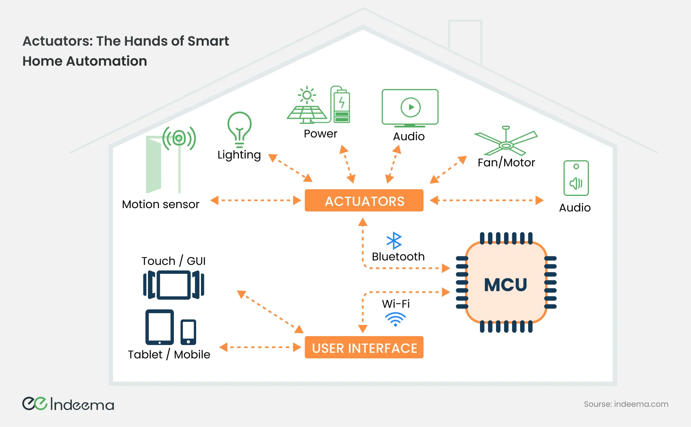

Slide 14
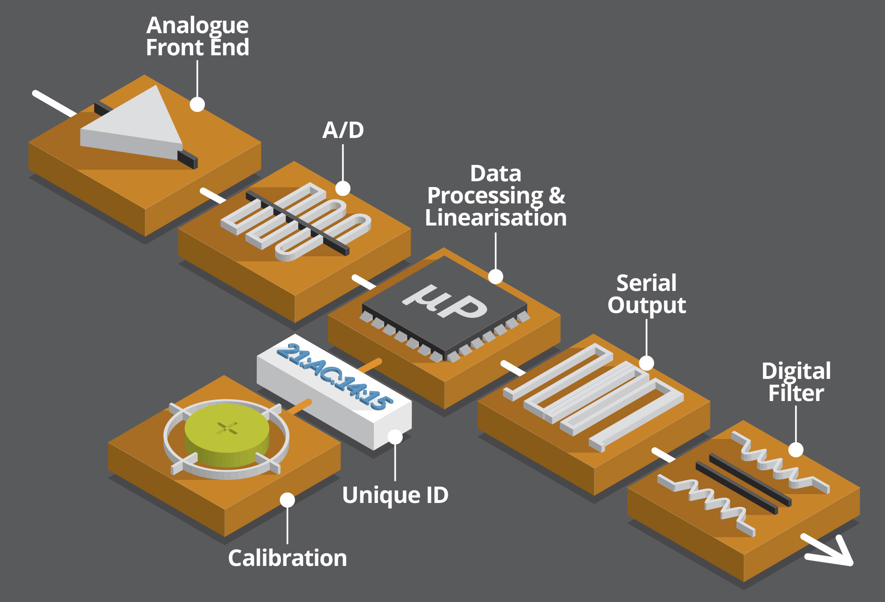

Slide 15
Key Characteristics of Smart Sensors in Pervasive Computing
Sensing and Data Acquisition
Smart sensors detect physical, chemical, or biological changes in the environment and convert them into digital signals. Common types of sensors include:
Temperature sensors (e.g., in HVAC systems)
Motion sensors (e.g., in security systems or automated lighting)
Light sensors (e.g., for smart street lighting)
Pressure sensors (e.g., for health monitoring or industrial systems)
Environmental sensors (e.g., humidity, pollution monitoring)
Embedded Processing
A smart sensor can pre-process the data it collects before transmitting it, reducing the amount of raw data sent to centralized systems. This processing can include:
Noise filtering: Reducing erroneous data.
Data aggregation: Summarizing or averaging multiple readings.
Feature extraction: Identifying key characteristics of the data, such as peaks in pressure readings or motion detection patterns.

Slide 16
Communication Capabilities
Smart sensors are designed to communicate with other devices or systems using wireless protocols such as:
Wi-Fi, Bluetooth, Zigbee, LoRaWAN: For different use cases depending on power requirements, distance, and bandwidth.
MQTT, CoAP, HTTP: Lightweight protocols for efficient communication, especially in IoT systems.
Sensors can communicate with a central server, gateway, or other devices in a distributed network (e.g., a smart home hub or industrial gateway).
Context-Awareness
Smart sensors can gather and respond to environmental context. For example, a sensor in a smart street lighting system can detect the ambient light level and automatically dim or brighten the lights based on the time of day or weather conditions.
Autonomy and Decision-Making
Some smart sensors are equipped with onboard intelligence that allows them to make local decisions. For example:
Motion sensors in a smart building could trigger alarms or lighting adjustments without needing input from a centralized system.
Health sensors worn by patients can detect abnormal heart rates and alert healthcare providers immediately.

Slide 17
Energy Efficiency
Smart sensors are often deployed in environments where energy resources are limited, such as battery-powered IoT devices. To conserve energy:
Low-power processors are used to reduce energy consumption.
Sleep modes are employed, where sensors activate only when needed (e.g., motion detection triggering activity).
Energy harvesting techniques (e.g., solar, thermal, or kinetic energy) may be employed in some devices to extend battery life or reduce dependency on external power sources.
Self-Diagnostics and Calibration
Smart sensors often come with self-calibration and self-diagnostic features to ensure accurate operation over time. They can automatically detect faults or errors in their readings and adjust themselves accordingly or notify the user/system of potential issues.

Slide 18
Types of Smart Sensors Used in Pervasive Computing
Environmental Sensors
Air Quality Sensors: Measure pollutants like CO2, CO, and particulate matter in smart cities to improve air quality.
Temperature and Humidity Sensors: Used in smart homes and agriculture for climate control and crop management.
Biometric Sensors
Heart Rate Monitors: Incorporated in wearable devices like fitness trackers to monitor users’ health in real-time.
Glucose Sensors: Used for continuous glucose monitoring in diabetic patients, providing real-time feedback for health management.
EEG and ECG Sensors: Used in healthcare for monitoring brain and heart activity remotely.

Slide 19
Proximity and Motion Sensors
Infrared Sensors: Used for motion detection in security systems, automated lighting, and HVAC systems.
Ultrasonic Sensors: Detect nearby objects, used in parking assistance or robotics for obstacle detection.
Optical and Imaging Sensors
Cameras and Optical Sensors: Used in surveillance systems or smart vehicles for obstacle detection, facial recognition, and traffic monitoring.
LIDAR Sensors: Used in autonomous vehicles and drones to map the environment in 3D for navigation and obstacle avoidance.
Smart Energy Meters
Measure power consumption and provide feedback to energy management systems, helping users optimize electricity use in homes or industrial settings.
Wearable Sensors
Integrated into devices like smartwatches and fitness bands to monitor various health parameters such as sleep patterns, step count, and body temperature.

Slide 20
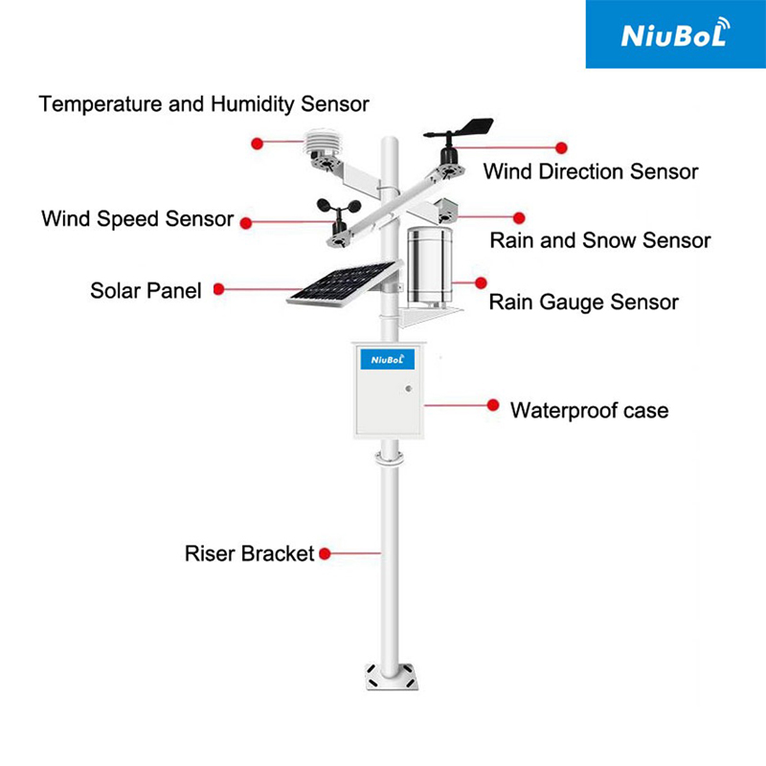
Smart farming Application
Soil Moisture Sensors: These sensors measure the moisture content in the soil, providing real-time data to farmers. This helps in efficient irrigation management, preventing over or under-watering of crops.
Weather Sensors: Weather sensors collect data on temperature, humidity, wind speed, rainfall, and solar radiation. This information aids in predicting weather patterns and adjusting farming practices accordingly.
Crop Health Sensors: These sensors monitor various parameters like chlorophyll content, leaf temperature, and plant stress levels. By detecting early signs of disease, nutrient deficiencies, or pest infestations, farmers can take timely actions to protect their crops.

Slide 21
pH Sensors: pH sensors measure the acidity or alkalinity of the soil. Maintaining the correct pH level is crucial for optimal nutrient uptake by plants. These sensors help farmers adjust soil pH and ensure proper crop growth.
Light Sensors: Light sensors monitor the light intensity and quality received by crops. This information enables farmers to optimize artificial lighting in indoor farming or adjust planting locations for better sunlight exposure.
Crop Yield Sensors: These sensors estimate crop yield by measuring factors such as plant height, canopy density, and fruit/vegetable size. This data assists farmers in planning harvest schedules and predicting market supply.
wind speed sensors: wind speed sensors are used to measure the strength and direction of the wind. This is useful for setting up sprinkler irrigation systems, preventing wind damage, and adjusting greenhouse ventilation. 4.
Water quality sensor: Water quality sensors are used to monitor the quality of irrigation water, including indicators such as pH, conductivity, and dissolved oxygen. This is essential to ensure the quality of irrigation water and reduce soil salinity and chemical buildup.
CO2 sensors: CO2 sensors are used to measure the concentration of CO2 in a greenhouse or indoor agricultural environment. This data can help farmers optimize greenhouse ventilation and CO2 fertilization to improve photosynthetic efficiency.
Level Sensors: Level sensors are used to monitor water levels in pools, tanks or irrigation systems. This helps to ensure that the irrigation system is functioning properly, avoiding water wastage and crop water shortages.

Slide 22
Medical Care Sensors
mmWave Sensor for Healthcare Applications (60GHz Radar Sensors)
The integration of radar sensor in healthcare applications enables non-intrusive and continuous monitoring, providing valuable insights into a person’s well-being.
mmWave based sensors can strike a balance between data collection for healthcare purposes and preserving individual privacy.
Radar(mmWave), traditionally associated with military and aviation applications, has found new ground in healthcare.
mmWave sensors operate by emitting electromagnetic waves and detecting their reflections from surrounding objects.
The raw data collected by mmWave-based sensors undergoes sophisticated signal processing and data analysis algorithms.
These algorithms filter out noise, extract relevant information, and provide a clear representation of vital signs or movement patterns.

Slide 23
Advantage of Using mmWave Sensor for Healthcare Applications
Privacy: camera is widely used for monitoring in both business and residential area. However, camera technology has privacy risk for any in-house monitoring. In contrast, an mmWave sensor only senses the motion of the target without rendering any picture that reveals personal identification, so an mmWave sensor is considered very safe for any indoor application.
Robustness: mmWave can work in any light conditions, day or night, foggy or rain. This allows robust performance in all weather conditions.
Aesthetics: mmWave sensor can see through most non-metallic covers, so no need to drill holes on the cover for sensing, which allows more appealing module design.
Motion sensitivity: mmWave sensor can detect very fine velocity called “microDoppler” information. This rich velocity information carries features that can be used for performance, gesture control, sleep monitoring, vital sign monitoring and even classifying different types of objects ( such as human vs. pets)
Low power: The new generation of mmWave radar sensors, are low power and consume only as a few milliwatts, which enables convenience with a battery powered full product and avoids cumbersome power lines

Slide 24
Fall detection
Millions of fall accidents happen for people older than 65.
One out of five falls causes a serious injury that requires urgent care. It is critical to report the injury on time, otherwise the patient can miss the best treatment timing window.
mmWave radar can reliably detect location information, height information as well as rich velocity information which can be utilized to detect the fall accident without any delay.
In the event of a fall, the sensor can trigger an alert, enabling timely intervention and reducing the risk of prolonged immobility and any proactive management of chronic conditions.
Furthermore, we know that fall accidents happen most often in the shower room. Without the privacy issue, mmWave sensor can be installed right inside the shower room and detect the fall accident even when the water is turned on.
The effectiveness of fall detection anywhere in the house can be a big health assistance for elderly people who are living alone.
Texas Instruments IWR6843
60GHz single chip radar sensor are deployed by several vendors to solve this application.

Slide 25
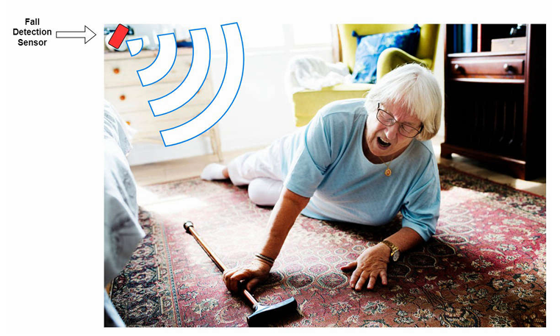
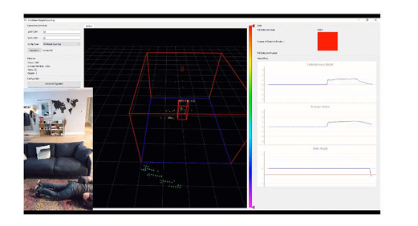

Slide 26
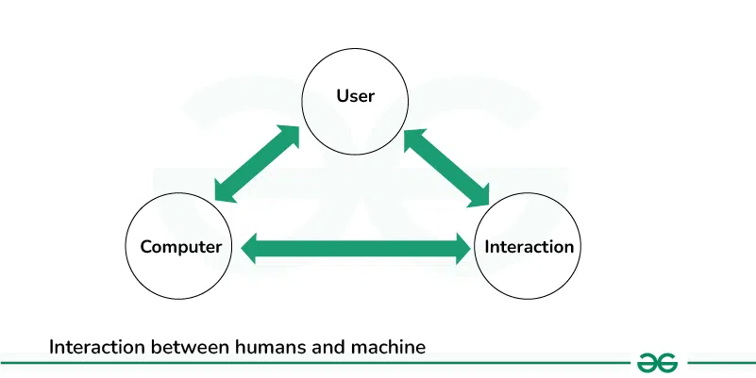
Human Computer Interaction (HCI)
HCI (Human Computer Interaction) is a field of study that refers to communication between the human user and a computer system.
Here interface refers to a medium or interaction between the computer and the end user.
It is also known as CHI (Computer Human Interface) or MMI (Man Machine Interaction).
It is concerned with design, evaluation, and implementation. It is used to provide a user-friendly environment.

Slide 27
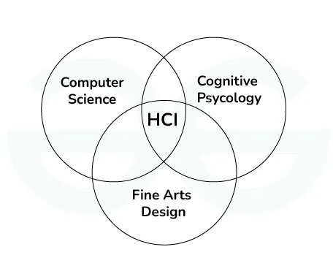
Human uses digital devices to perform various activities.
HCI is to design a systems in such a way that make them efficient, stable, usable and attainable.
Lack of communication can result in poor designed user interfaces.
It provides a ways to reduce design time through various task models. There are some disciplines contributing to HCI.

Slide 28
Computer Science
Computer science is a field of computation and information. Computer science plays a crucial role in modern development of HCI. Smart Television, Voice assistant, AR/VR technology and gaze detection are some of the technology exists in modern world, that are running our day to day life.
Cognitive Psychology
It is a field of HCI which identifies how human interact with systems. It includes Language based interaction, a set of rules are provided to the system. Based on that rules we create our model. It also includes Human motor skills, where we identifies physical characteristics of user and based on that characteristics we create our model.

Slide 29
Input and Output devices
Input are actions received from user and output are the signals that sent back to user by system. It acts as a medium between computer and user. Some of the examples of input and output devices are as follows.
Input devices
Keyboard
Mouse
Light pen
Microphone
Bar code reader
Output Devices
Monitor
Television
Printer
Speakers
Headphones

Slide 30
Interaction Styles
Command Line: It is one of the oldest interaction style present today. But it is not user friendly because user needs to learn so many commands. Each task or work have it’s own command, you have to be expert or proficient in writing these commands.
Graphic user interface: It is one of the popular interaction style available today. Operating systems like Windows and macOS are the best style of GUI, where user can provide input with the help of mouse and keyboard.
Natural Language: It is one step ahead of GUI. We can interact with system by the help of languages that we are using in our day to day life. Alexa, Siri, Google voice are the best example of voice assistant that uses natural language.
Q/A (Question and Answer): The best example of this interaction style are chatbots. Every application whether it is web or mobile application has chatbot now a days. But chatbots are always domain specific not universal.

Slide 31
Use Cases of HCI
Smart home: Smart homes refers to home amenities that have been fitted with communication technology enabling some degree of automation or remote control. It includes control of air conditioning, heating and lighting through voice activated commands or mobile app. Home security systems are also fitted with communication technology to alert the residents in case of burglary.
Biometric Sensors: Biometric sensors are the use of human biometrics in various technological applications. It can be used in access controls for example granting access to a computer network or security system.
Autonomous vehicle: An autonomous vehicle is one that can drive itself. Tesla is a company which pioneered the engineering of autonomous driving vehicles. It has advanced autopilot technology which allows real time navigation updates.

Slide 32
Virtual assistants: Another innovation in this era is the intelligent virtual assistant or intelligent personal assistant. It is a software agent that can perform task or services or an individual based on commands or questions. These virtual assistants can interpret human speech and respond via voices.
Smart phones for Visual Disabilities: There are some features present in smart phones that make the life of people with disabilities easy. Voiceover is a screen reader which basically means that your phone will talk out loud and tell you what’s on the screen. User can control it with certain touch gestures. There are some other features also like Magnification.

Slide 33
Human–Computer Interaction (HCI) for AI Systems Design
Human-Computer Interaction (HCI) for AI Systems Design refers to the study and practice of designing, implementing, and evaluating AI systems with a focus on the interaction between humans and computers.
The goal is to create AI systems that are user-friendly, efficient, and effective in supporting human tasks and activities. HCI principles are applied to ensure that AI systems are designed with the user's needs, abilities, and preferences in mind, and that they enhance human capabilities rather than replace them.

Slide 34
Key aspects of HCI for AI Systems Design include:
User-Centered Design: Placing the user at the center of the design process to ensure that AI systems meet their needs and preferences. This involves understanding the user's context, tasks, and goals, and designing the system accordingly.
Usability: Ensuring that AI systems are easy to learn, efficient to use, and satisfying for the user. This involves designing intuitive interfaces, providing clear feedback, and minimizing errors.
Accessibility: Designing AI systems that are accessible to all users, including those with disabilities. This involves considering diverse user abilities and providing appropriate accommodations.
Transparency and Explainability: Making the AI system's decision-making processes transparent and understandable to users, so they can trust and effectively interact with the system.

Slide 35
Ethics and Privacy: Ensuring that AI systems are designed and used in an ethical manner, respecting user privacy and data security.
Collaboration and Communication: Facilitating effective collaboration and communication between humans and AI systems. This involves designing interfaces and interaction modes that support seamless integration of AI into human workflows.
Evaluation: Conducting user studies and evaluations to assess the usability, effectiveness, and user satisfaction of AI systems. This helps identify areas for improvement and ensures that the system meets user needs.

Slide 36
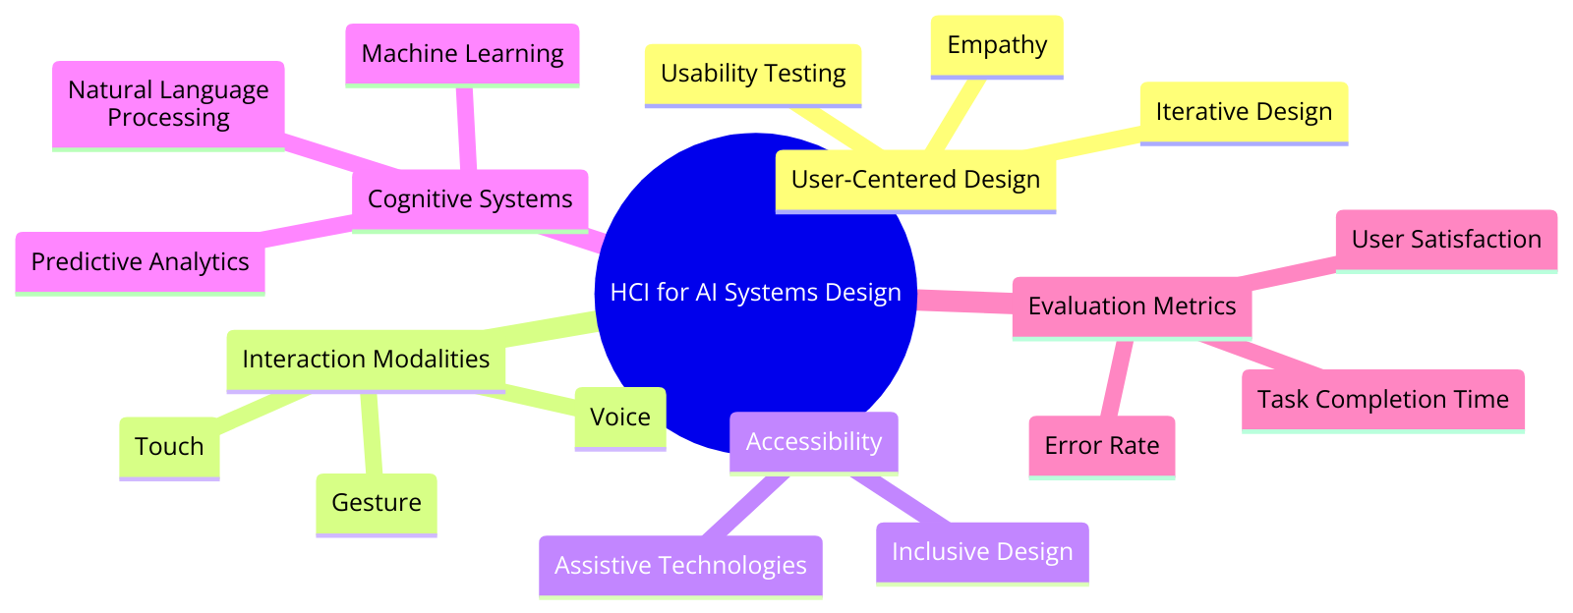
Tried to create a mindmap diagram illustrating HCI for AI Systems Design.

